Slide 1
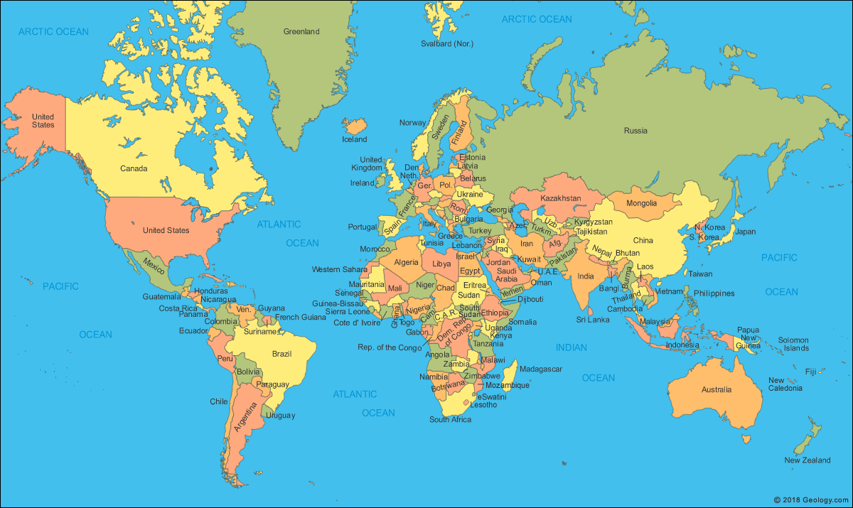
Where in the world would you like to go on holiday?
This Photo by Unknown Author is licensed under CC BY-NC-ND

Slide 2
School in the time of Covid 19
A right or a privilege?
By E. Brightwood

Slide 3
What comes to mind when you here these words?
Rights
Education
Privilege

Slide 4
Have you heard about the UN convention on the rights of the child?
https://childrensrights.ie/childrens-rights-ireland/un-convention-rights-child

Slide 5
Survival rights: include the child’s right to life and the needs that are most basic to existence, such as nutrition, shelter, an adequate living standard, and access to medical services.
Development rights: include the right to education, play, leisure, cultural activities, access to information, and freedom of thought, conscience and religion.
Protection rights: ensure children are safeguarded against all forms of abuse, neglect and exploitation, including special care for refugee children; safeguards for children in the criminal justice system; protection for children in employment; protection and rehabilitation for children who have suffered exploitation or abuse of any kind.
Participation rights: encompass children's freedom to express opinions, to have a say in matters affecting their own lives, to join associations and to assemble peacefully. As their capacities develop, children should have increasing opportunity to participate in the activities of society, in preparation for adulthood.
https://childrensrights.ie/childrens-rights-ireland/un-convention-rights-child

Slide 6
Everyone under 18 has the right to:
To play and rest.
Give your opinion
Find out things
Share what you think by drawing,
talking or writing
Practice your own culture, language and religion.
Your education should help use and develop your talents and abilities.
A good quality education. You should be encouraged to go to school to the highest level that you can.
Protection from work that harms you.
Join or set up groups
Special education care if you have a disability
To know your rights.
Get information that is important to your wellbeing
A clean and safe environment
Choose your own friends
https://docs.google.com/viewer?url=https://eprcug.org/children/engage/kids-engage/un-convention-on-therights-of-the-child/download?p=1

Slide 7
Where in the world would you like to be educated?
This Photo by Unknown Author is licensed under CC BY-NC-ND

Slide 8
Barriers
Boosters
School during Covid 19

Slide 9
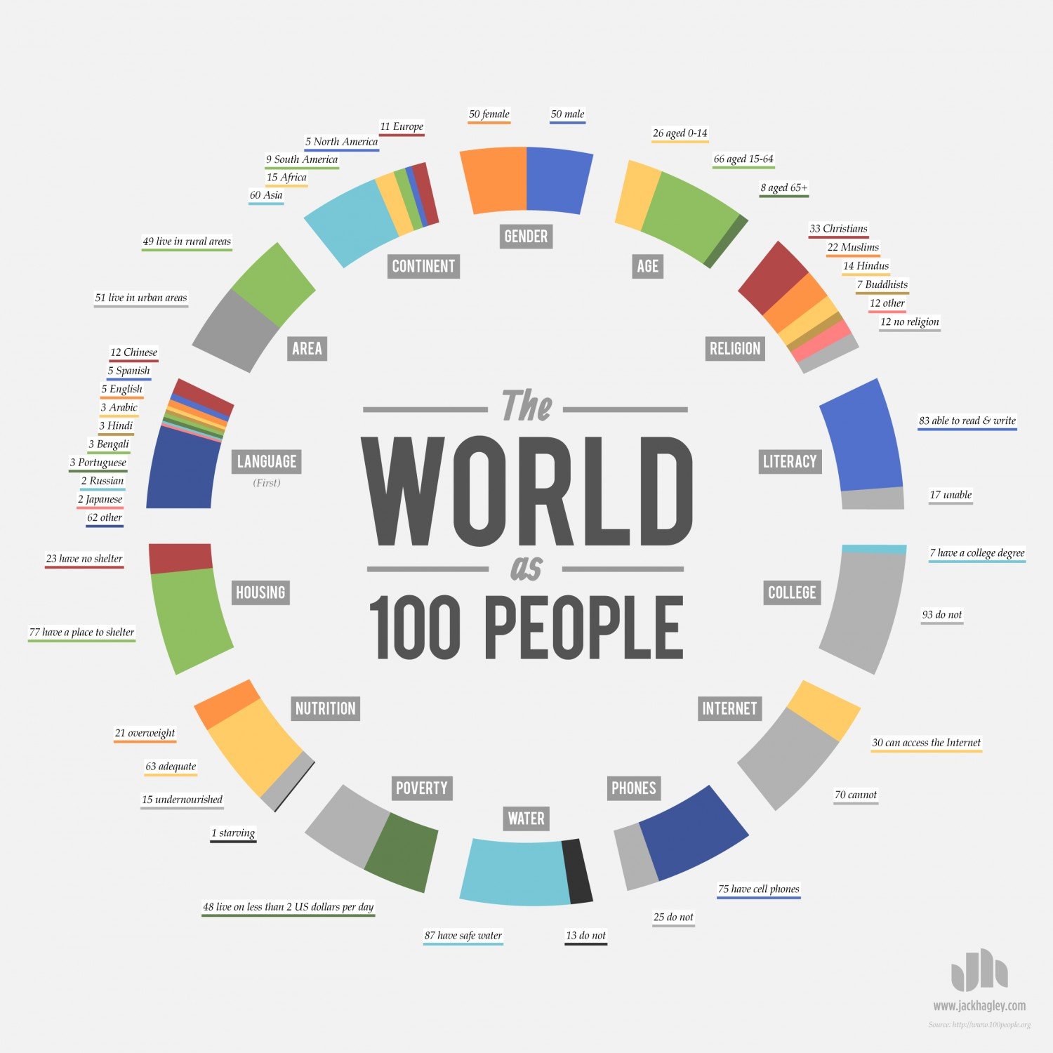
If there world were 100 people how many would have an internet connection?
https://public.tableau.com/profile/msutrave#!/vizhome/Worldas100People/TheWorldas100People
https://www.100people.org/statistics_100stats.php?section=statistics
This Photo by Unknown Author is licensed under CC BY-SA-NC

Slide 10
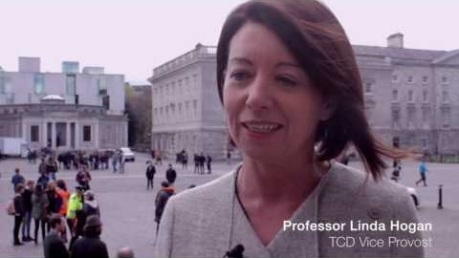

Slide 11
If you are right-handed, take one step forward.
If English is your first language, take one step forward.
If you studied the culture of your ancestors in school, take one step forward.
If you often feel that your parents are too busy to spend time with you, take one step back.
If one or both of your parents have a college degree, take one step forward.
If your family has ever left your homeland or entered another country not of your own free will, take one step back.
If you were ever discouraged from an activity because of race, class, ethnicity, gender, disability, or sexual orientation, take one step back.
If your family owns a computer, take one step forward.
If you have ever been able to play a significant role in a project or activity because of a talent you gained previously, take one step forward.
If you ever had to skip a meal or were hungry because there was not enough money to buy food, take one step back.
If you come from a single-parent household, take one step back.
If someone in your household suffered or suffers from mental illness, take one step back.
If you ever tried to change your appearance, mannerisms, or behavior to fit in more, take one step back.
If you were ever accepted for something you applied to because of your association with a friend or family member, take one step forward.
If you feel respected for your academic performance, take one step forward.
If you have a physically visible disability, take one step back.
If you have an invisible illness or disability, take one step back.
If you have ever been spoken over because you could not articulate your thoughts fast enough, take one step back.
If you are never asked to speak on behalf of a group of people who share an identity with you, take one step forward.
If you have always assumed you’ll go to college, take one step forward.
If you have more than fifty books in your household, take one step forward.
If your parents have told you that you can be anything you want to be, take one step forward.
https://peacelearner.org/2016/03/14/privilege-walk-lesson-plan/

Slide 12
Sources and additional reading
If the world was 100 people, 2016 https://www.100people.org/statistics_100stats.php?section=statistics
Meghana Sutrave, The world as 100 people infographic, 2017 https://public.tableau.com/profile/msutrave#!/vizhome/Worldas100People/TheWorldas100People
Valerie Strauss, The Washington post, 1.5 billion children around globe affected by school closure. What countries are doing to keep kids learning during pandemic., March 2020 https://www.washingtonpost.com/education/2020/03/26/nearly-14-billion-children-around-globe-are-out-school-heres-what-countries-are-doing-keep-kids-learning-during-pandemic/
UN News, Startling disparities in digital learning emerge as COVID-19 spreads: UN education agency, April 2020 https://news.un.org/en/story/2020/04/1062232
Jason Miks & John McIlwain, Unicef, Keeping the world’s children learning through COVID-19, April 2020 https://www.unicef.org/coronavirus/keeping-worlds-children-learning-through-covid-19
The Children's Rights Alliance, The United Nations Convention on the Rights of The Child, https://childrensrights.ie/childrens-rights-ireland/un-convention-rights-child
Childs Rights Coalition Asia, UNCRC Child –Friendly versions, February 2016 https://www.crcasia.org/uncrc-child-friendly-versions/
Peach Learner, Privilege Walk Lesson Plan, March 2016 https://peacelearner.org/2016/03/14/privilege-walk-lesson-plan/
Trinity College Dublin, The TAP Privilege walk, June 2016 https://www.youtube.com/watch?v=A1a5hwggtYQ
UNESCO, Reopening schools: When, where and how? May 2020 https://en.unesco.org/news/reopening-schools-when-where-and-how

